Slide 1
BLOCK CIPHER
BLOW FISH

Slide 2
Stream Cipher & Block Cipher
Stream cipher technique involves the encryption of one plain text byte at a time.
The decryption also happens one byte at a time.
Block cipher technique involves encryption of one block(group of bytes) of a text at a time.
The decryption also happens one block of encrypted text at a time.

Slide 3
Diffusion and Confusion
Shannon introduced the principles of Diffusion and Confusion for encryption.
Idea: break dependencies and introduce as much randomness in the cipher text.
Main objective: Difficult cryptanalysis of cipher text.
Stream cipher relies only on confusion.
Block cipher uses both confusion and diffusion.
Henric Johnson

Slide 4
Diffusion and Confusion…
Diffusion:
“The statistical structure of the plaintext is spread (dissipated) into long-range statistics of the ciphertext.”
Achieved by having each plaintext digit affect the value of many ciphertext digits.
Ex. Transposition cipher.
Henric Johnson

Slide 5
Diffusion and Confusion…
Confusion: It is a technique of ensuring that a cipher text gives no clue about the original plain text.
“Attempts to make the relationship between the ciphertext and the encryption key as complex as possible.”
Achieved by using a complex substitution algorithm.
Even if an attacker can some handle on the statistics of the ciphertext, it is very difficult to deduce the key.
Ex. Substitution cipher.
Henric Johnson

Slide 6
Feistel Cipher Structure
Has the following design parameters:
Block size: larger block sizes mean greater security but lower encryption/decryption speed.
(64 bits block size is a good compromise.)
Key Size: larger key size means greater security but lower encryption/decryption speed.
(Appropriate key size is a function of how fast
processors are.)
Number of rounds: multiple rounds offer increasing security.
(16 rounds are mostly used.)
Henric Johnson

Slide 7
Feistel Cipher Structure...
Subkey generation algorithm: Greater complexity of this algorithm will lead to greater difficulty of cryptanalysis.
Round function: The greater the complexity of rounds function, the greater the resistance to cryptanalysis.
Henric Johnson

Slide 8
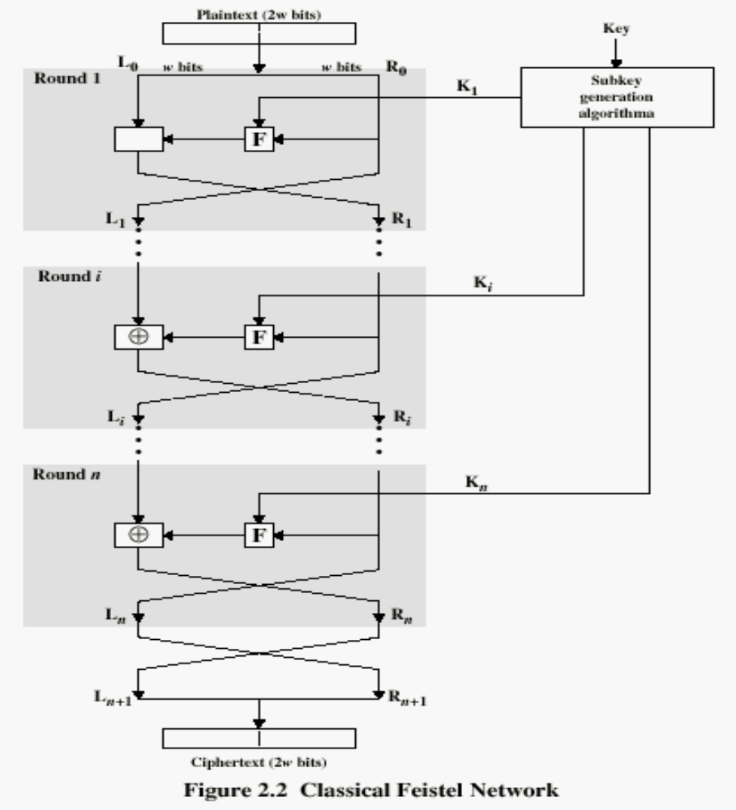
Henric Johnson

Slide 9
Other Symmetric Block Ciphers
Blowfish
  Easy to implement (simple structrure)
  High execution speed
  Run in less than 5K of memory
  Variable security: key length is variable.
  (can be as long as 448 bits, range 32..448).
  > Allows a tradeoff between speed and security.
  -The key is used to generate 18 32-bit subkeys.
  -Encryption/decryption consist of 16 rounds.
Henric Johnson

Slide 10
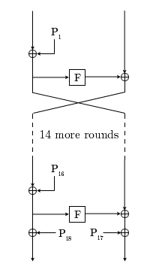
INPUT 64 BITS

Slide 11
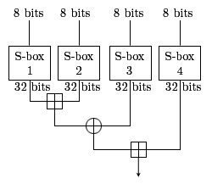
Diagram of Blowfish's F function

Slide 12

DESCRIPTION OF THE ALGORITHM
Blowfish is a variable-length key, 64-bit block cipher.
The algorithm consists of two parts: a key-expansion part and a data- encryption part.
Key expansion converts a key of at most 448 bits into several subkey arrays.
Data encryption occurs via a 16-round Feistel network.
Each round consists of a key-dependent permutation, and a key- and data-dependent substitution.
All operations are XORs and additions on 32-bit words.
The only additional operations are four indexed array data lookups per round.

Slide 13
Subkeys:
Blowfish uses a large number of subkeys. These keys must be precomputed before any data encryption or decryption.
1. The P-array consists of 18 32-bit subkeys:
P1, P2,..., P18.
2. There are four 32-bit S-boxes with 256 entries each:
S1,0, S1,1,..., S1,255;
S2,0, S2,1,..,, S2,255;
S3,0, S3,1,..., S3,255;
S4,0, S4,1,..,, S4,255.

Slide 14
1. Initialize first the P-array and then the four S-boxes, in order, with a fixed string. This string consists of the hexadecimal digits of pi (less the initial 3). For example:
P1 = 0x243f6a88
P2 = 0x85a308d3
P3 = 0x13198a2e
P4 = 0x03707344
2. XOR P1 with the first 32 bits of the key, XOR P2 with the second 32-bits of the key, and so on for all bits of the key (possibly up to P14). Repeatedly cycle through the key bits until the entire P-array has been XORed with key bits.

Slide 15
Do a bit wise XOR of p1 with k1 ,same p2 with k2….This works fine till p14 and k14.
At this stage the key array is exhausted.
Hence for p15 to p18 reuse k1 to k4.
P1 = p1 xor k1
P2 = p2 xor k2
…
P18 = p18 xor k4.

Slide 16
FUNCTION
The diagram to the right shows Blowfish's F-function. The function splits the 32-bit input into four eight-bit quarters, and uses the quarters as input to the S-boxes. The outputs are added modulo 2³² and XORed to produce the final 32-bit output.

